Slide 1
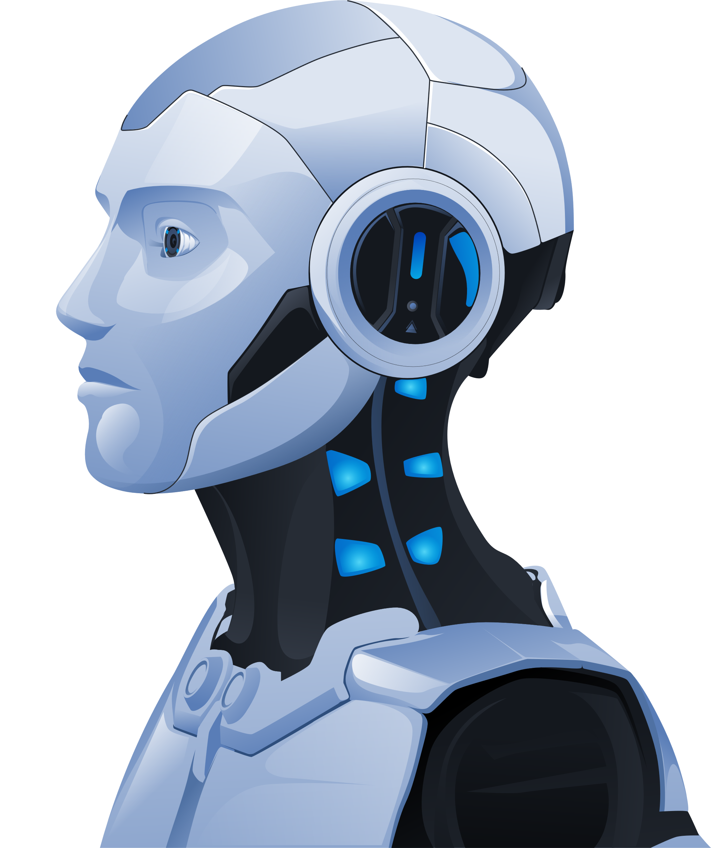
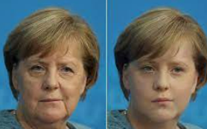
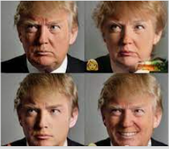
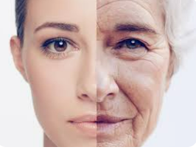
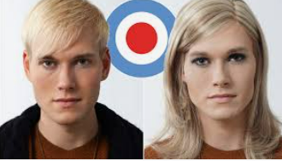
Face App

Slide 2
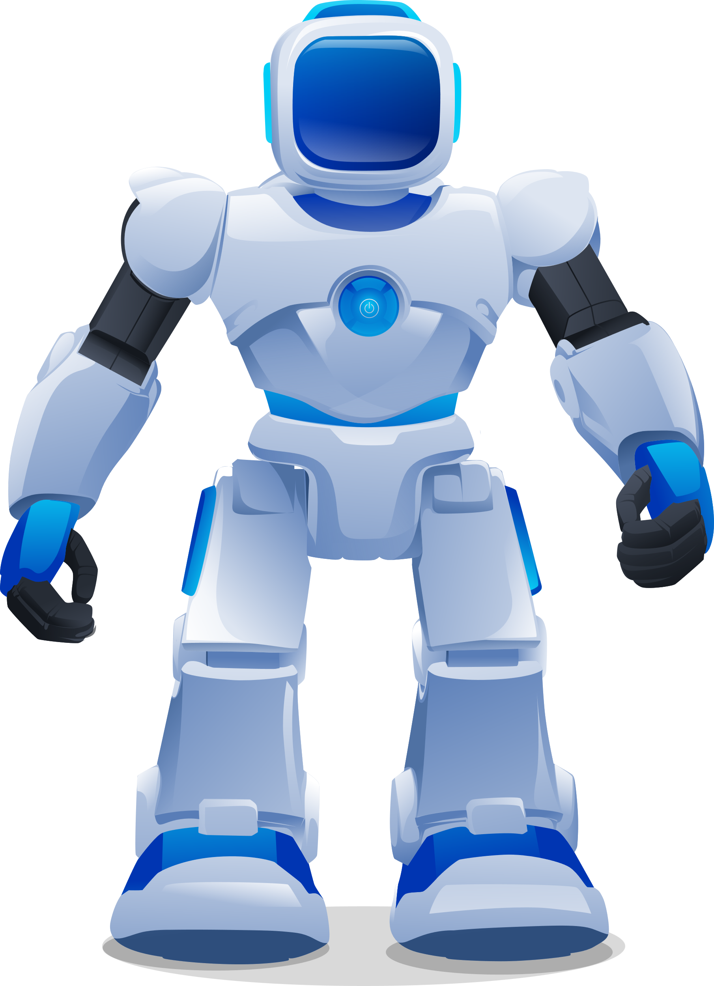
What Is Face App
FaceApp is a photo-editing app developed by a Russian company called Wireless Lab.The app first became popular in 2017 and gained a lot of attention for its ability to make edited.
people look older or younger, depending on the filter selected.
AI in FaceApp uses a combination of computer vision deep learning, and machine learning techniques to analyze and manipulate the facial features in photos allowing users to transform their appearance in various ways.

Slide 3


Different Types of Face Apps
Age filter: which uses AI technology to modify a photo to make a person look younger or older.
Genderswap: This filter allows users to change their gender in a photo, making them appear as male or female.
Hairstyle and hair color: FaceApp allows users to modify their hair color and style.
Makeup: This app has a variety of makeup filters that allow users to apply lipstick, eye shadow, blush, and other makeup products to their photos.
Smile: This filter can add a smile to a person's face.
Backgrounds: FaceApp also allows users to change the background of their photos,
Morphing: This feature allows users to combine two faces into one, creating a blended
image of two people.
8. Emojis and stickers: Have variety emojis and fun sticker.

Slide 4
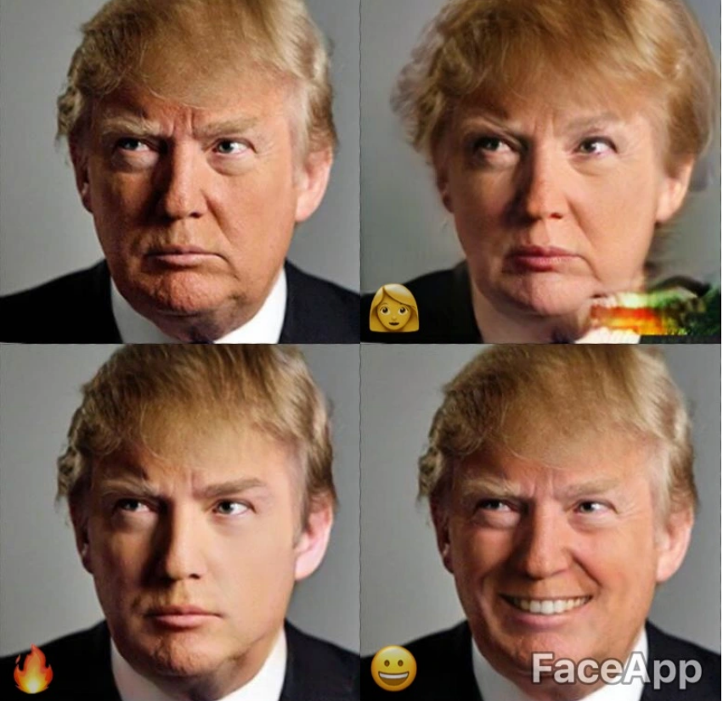
Some results (such as the added smile) look generally more plausible than others (the aging effect is pretty obviously unreal).

Slide 5
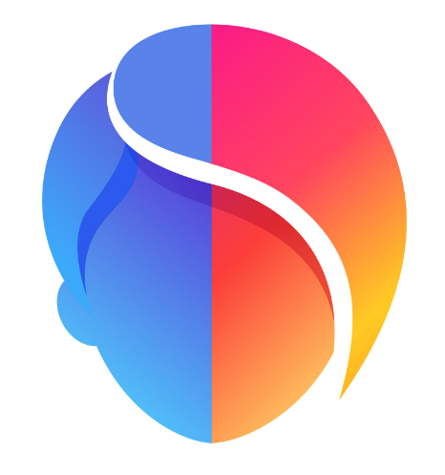



Most popular Face App
FaceApp
Snapchat
YouCam Makeup
Facetune

Slide 6
Face App has been popular in many countries worldwide
Japan
Countries, where it’s been making the biggest splash so far, include Japan, Netherlands, Hong Kong, Norway, Russia, and Argentina, with Goncharov noting the app has topped the App Store charts in four countries, and made top iOS app in the Photo & Video category in seven so far.
Russia
Netherlands
Norway
Hong Kong

Slide 7
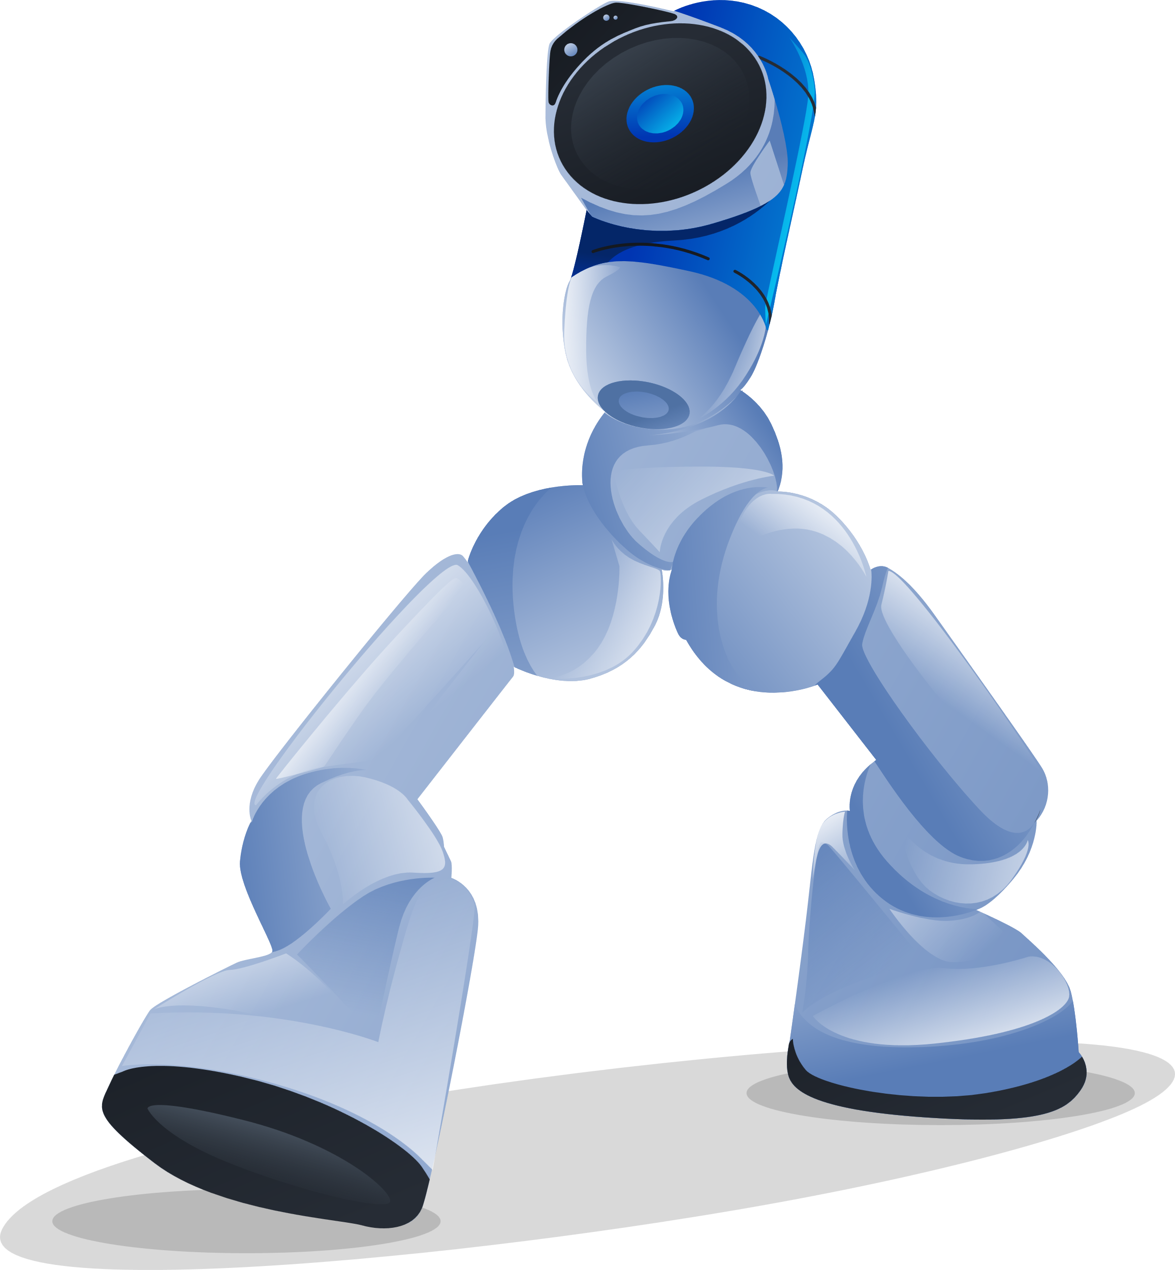
THANK YOU
Eli

